Slide 1

Binary Classification
Of Fake or Real News
John Nicholas
Niko Kristanto
Vanessa Christy
Wesley Susanto
Data taken from: https://www.kaggle.com/clmentbisaillon/fake-and-real-news-dataset

Slide 2
Work Contributions
Binary Classification of Fake or Real News
Group 01
Niko Kristanto
Wesley Susanto
Vanessa Christy
John Nicholas
Project Manager
Data Cleaning
Exploratory Data Analysis
TF-IDF
GloVe
BERT

Slide 3
Table of Contents
Introduction
Data Preparation
Data Visualization
Data problems + Objective
Creating Model
TF-IDF
GloVe
BERT
Evaluation

Slide 4
INTRODUCTION
What is our dataset about?
Fake and True dataset consisting of: title, text of article, subject of article, and date the article was posted
Objective:
Classify whether a news is a fake or real news
Help increases credibility of news spread in the social media to decrease hoax rate
Natural Language Processing problem

Slide 5


Preparing Dataset
Eliminating the word ‘Reuters’ and the city name preceding it + Dropping unwanted columns

Slide 6
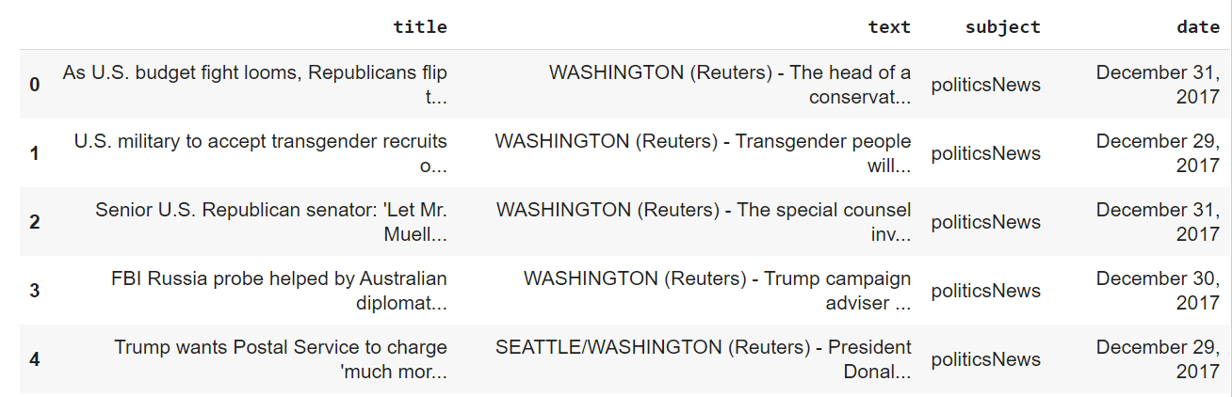
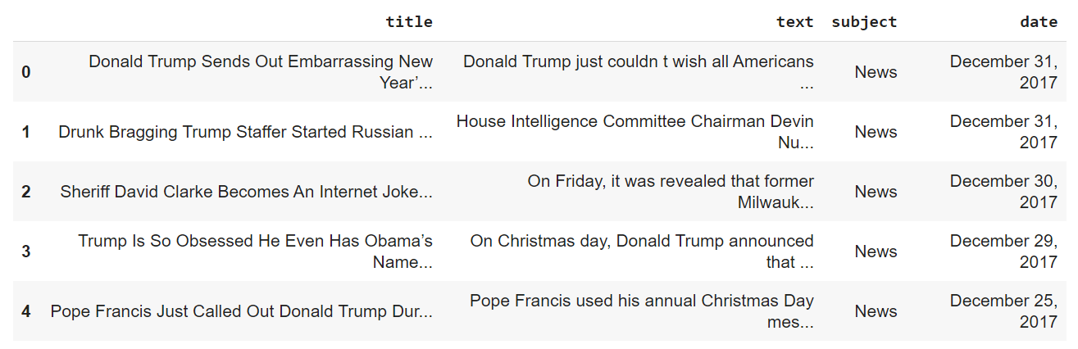
real.head()
Contains city name and “Reuters” in front of the text
fake.head()

Slide 7
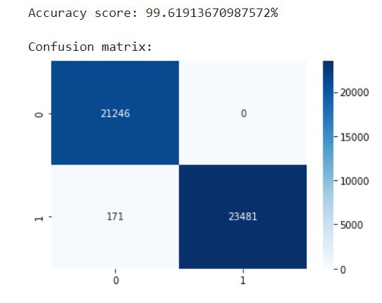
Predict Real News when the text contains “(Reuters)”
After combining real and fake data with no reuters, we proceed to find via the confusion matrix, that the accuracy is 99.6% with only that condition. Therefore, we need to delete ‘(Reuters)’ and city name if it appears in the first 5 words.

Slide 8
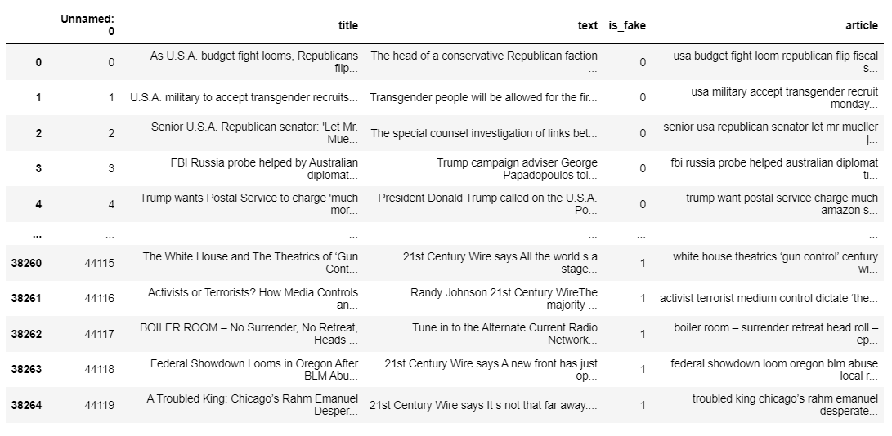
Data Cleaning
Check for empty values, remove duplicates, dropping irrelevant columns, removing stopwords and apply word lemmatization for the article column
Cleaned Data: 38265 rows x 5 column

Slide 9

Visualization

Slide 10
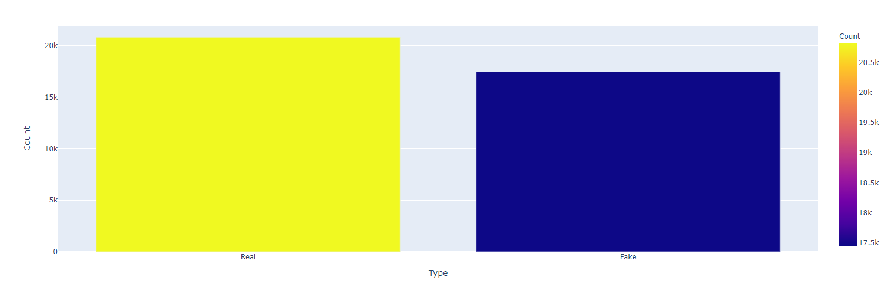
Count of Fake and Real News
Real : Fake -> 20821:17445, which is around 1.19:1.
It is not too imbalanced, so we can use accuracy as our metrics.
Our baseline model would be 54.41%. (Real / Total Data)

Slide 11
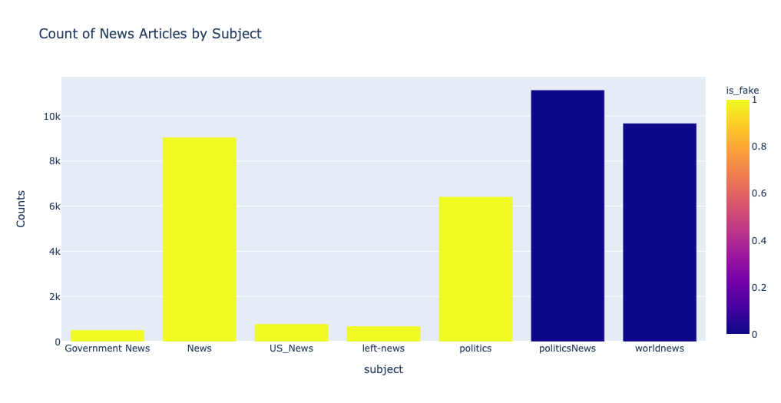
Bar Plot of News Article
Our dataset is mainly about politics around the world.

Slide 12
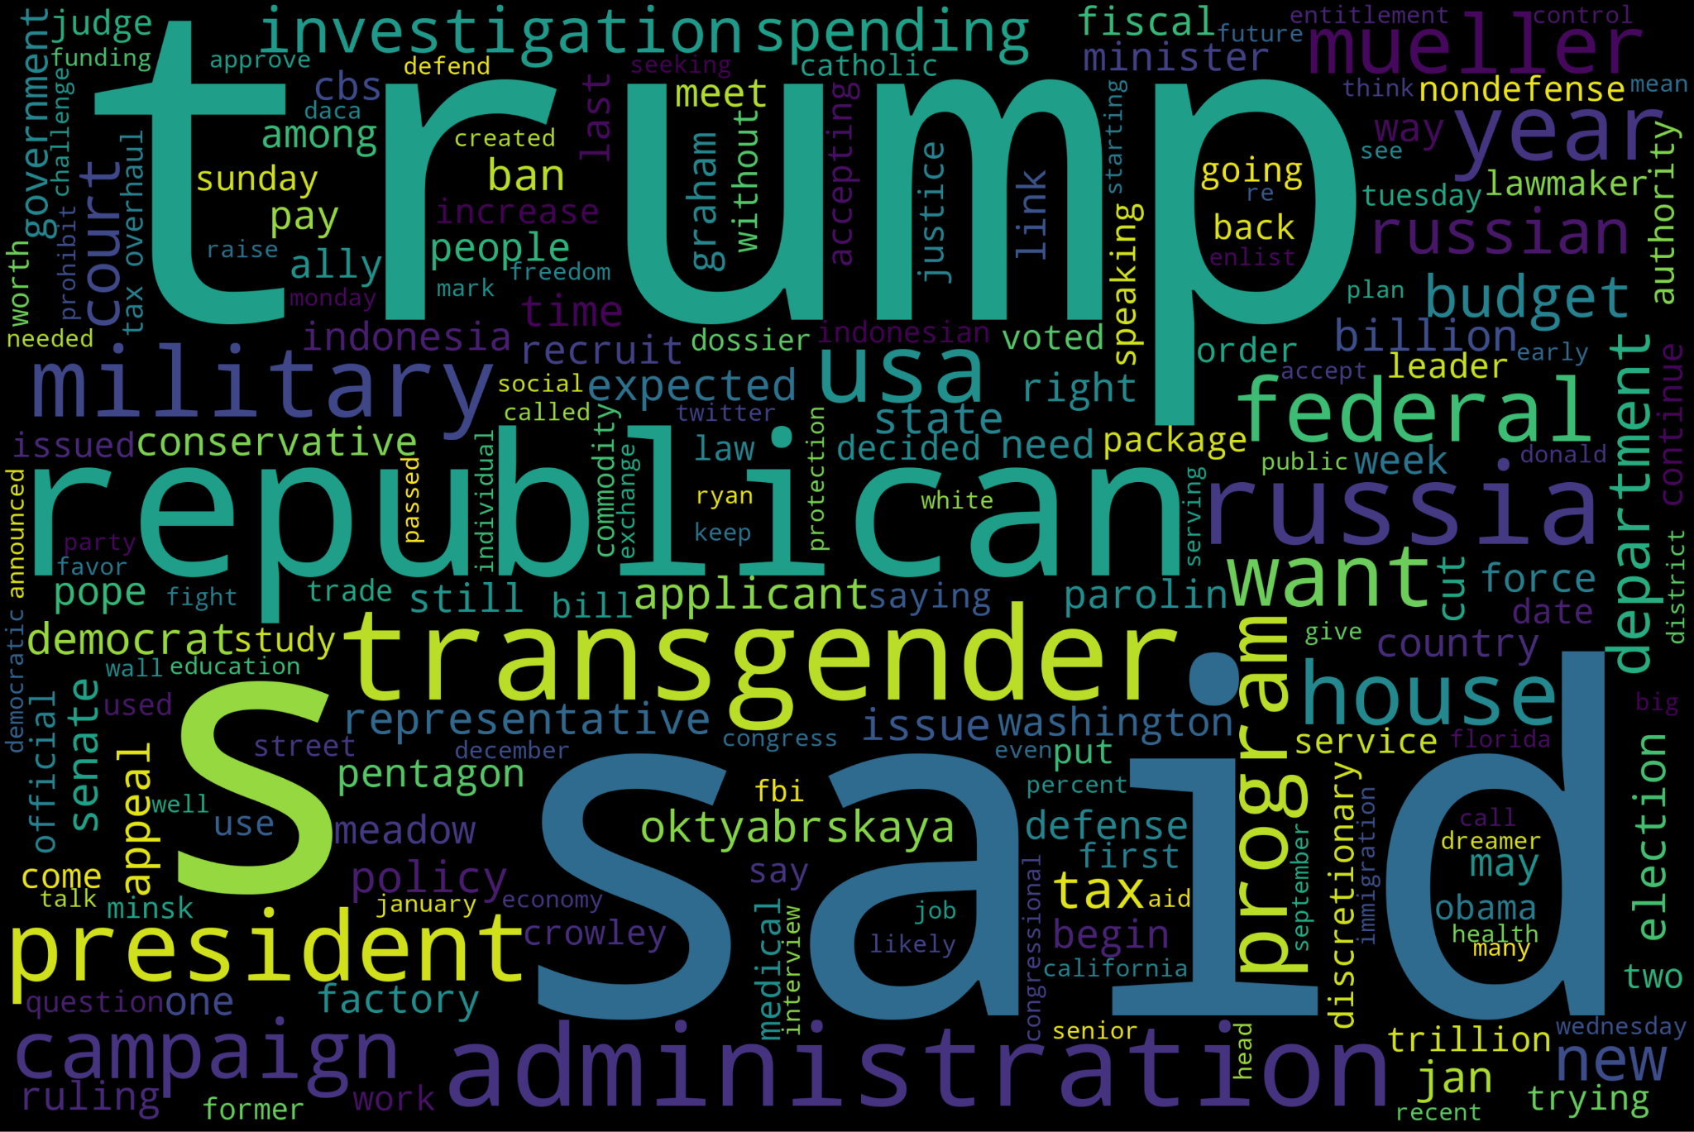
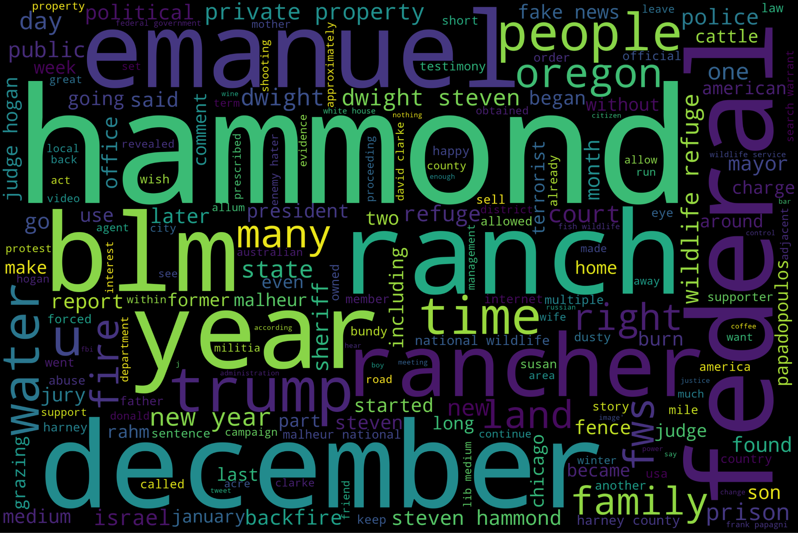
WordCloud
Real
Fake

Slide 13
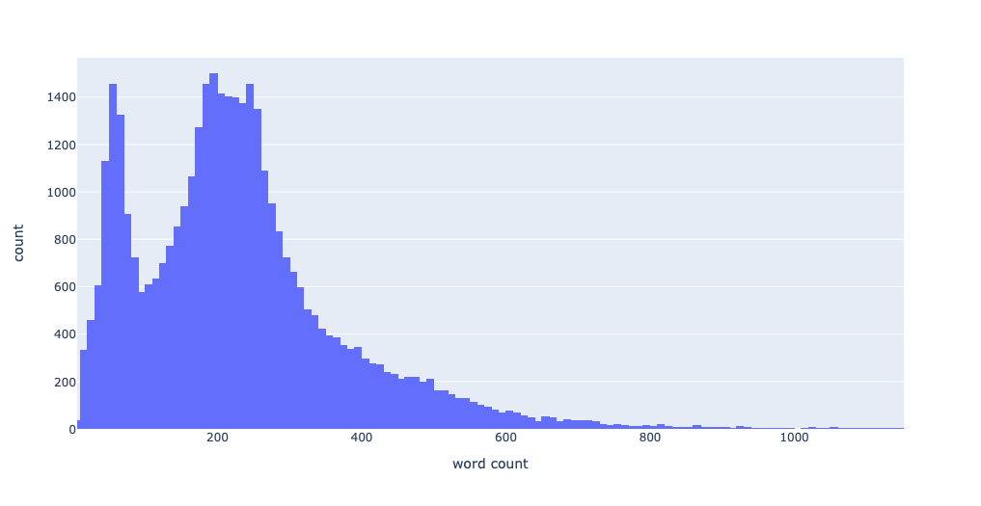
Word Count
Majority of our articles have less than 250 words. Therefore,we can set our max word to 250 to save some computing power without sacrificing our model’s performance.

Slide 14
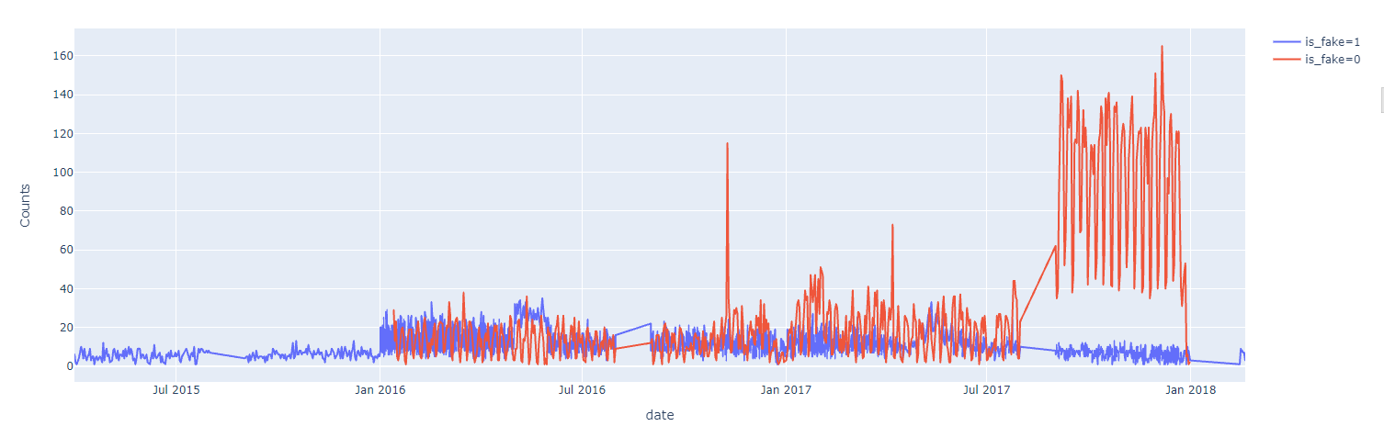
Fake data counts based on date posted

Slide 15

CREATING MODELS

Slide 16
TF-IDF

Slide 17

What Is TF-IDF

Slide 18
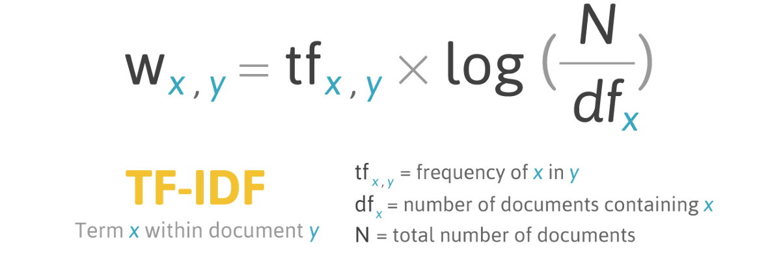
What Is TF-IDF

Slide 19
What Is TF-IDF
In Short, TF-IDF is a way to judge the importance of a word by its frequency in both the data and the dataset

Slide 20
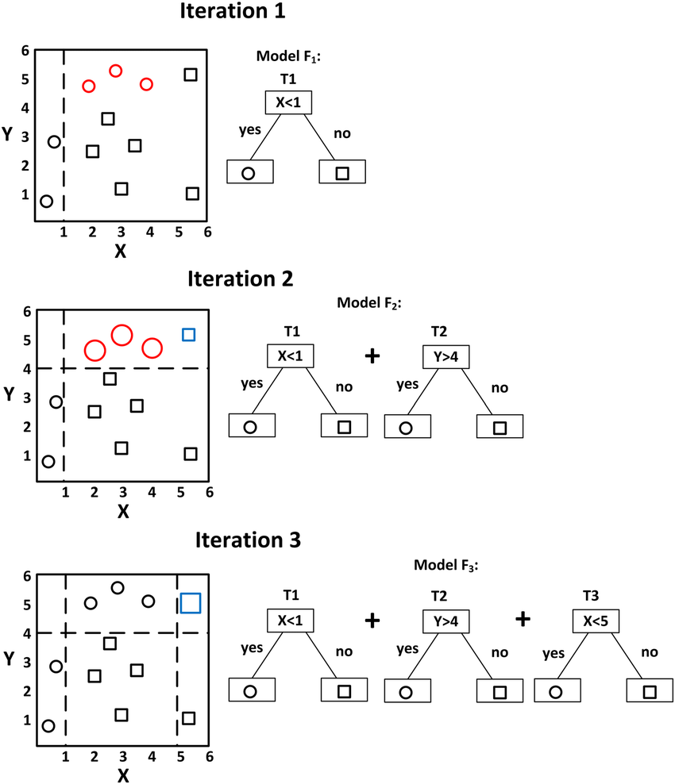
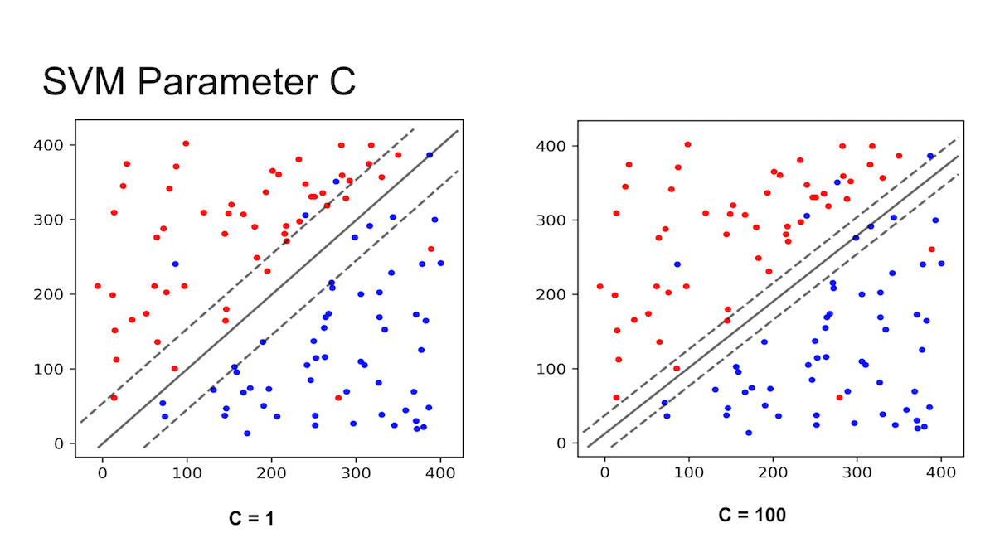
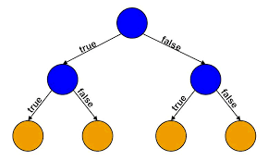

What’s Next?
Now We have known that TF-IDF is used for counting the weight of each word, but then what’s the use?
XGBoost
We use Differents Model Classifier to help us translate these weight into a working Machine learning model
Linear SVM
This time, we use
Decision Tree
Random Forest

Slide 21
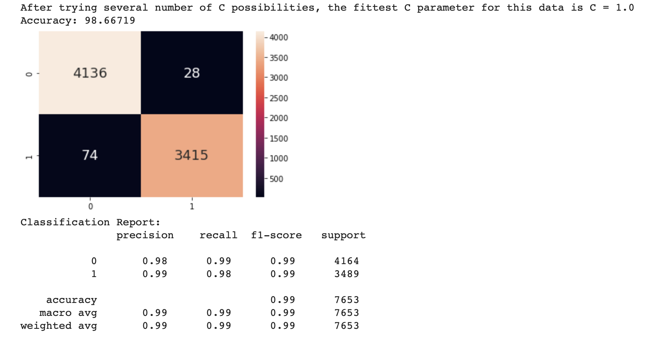
Linear SVM
In this Model, we try several different C’s value which results in value of C = 1.0 to be most suitable for the data with 98.7% accuracy on test data

Slide 22
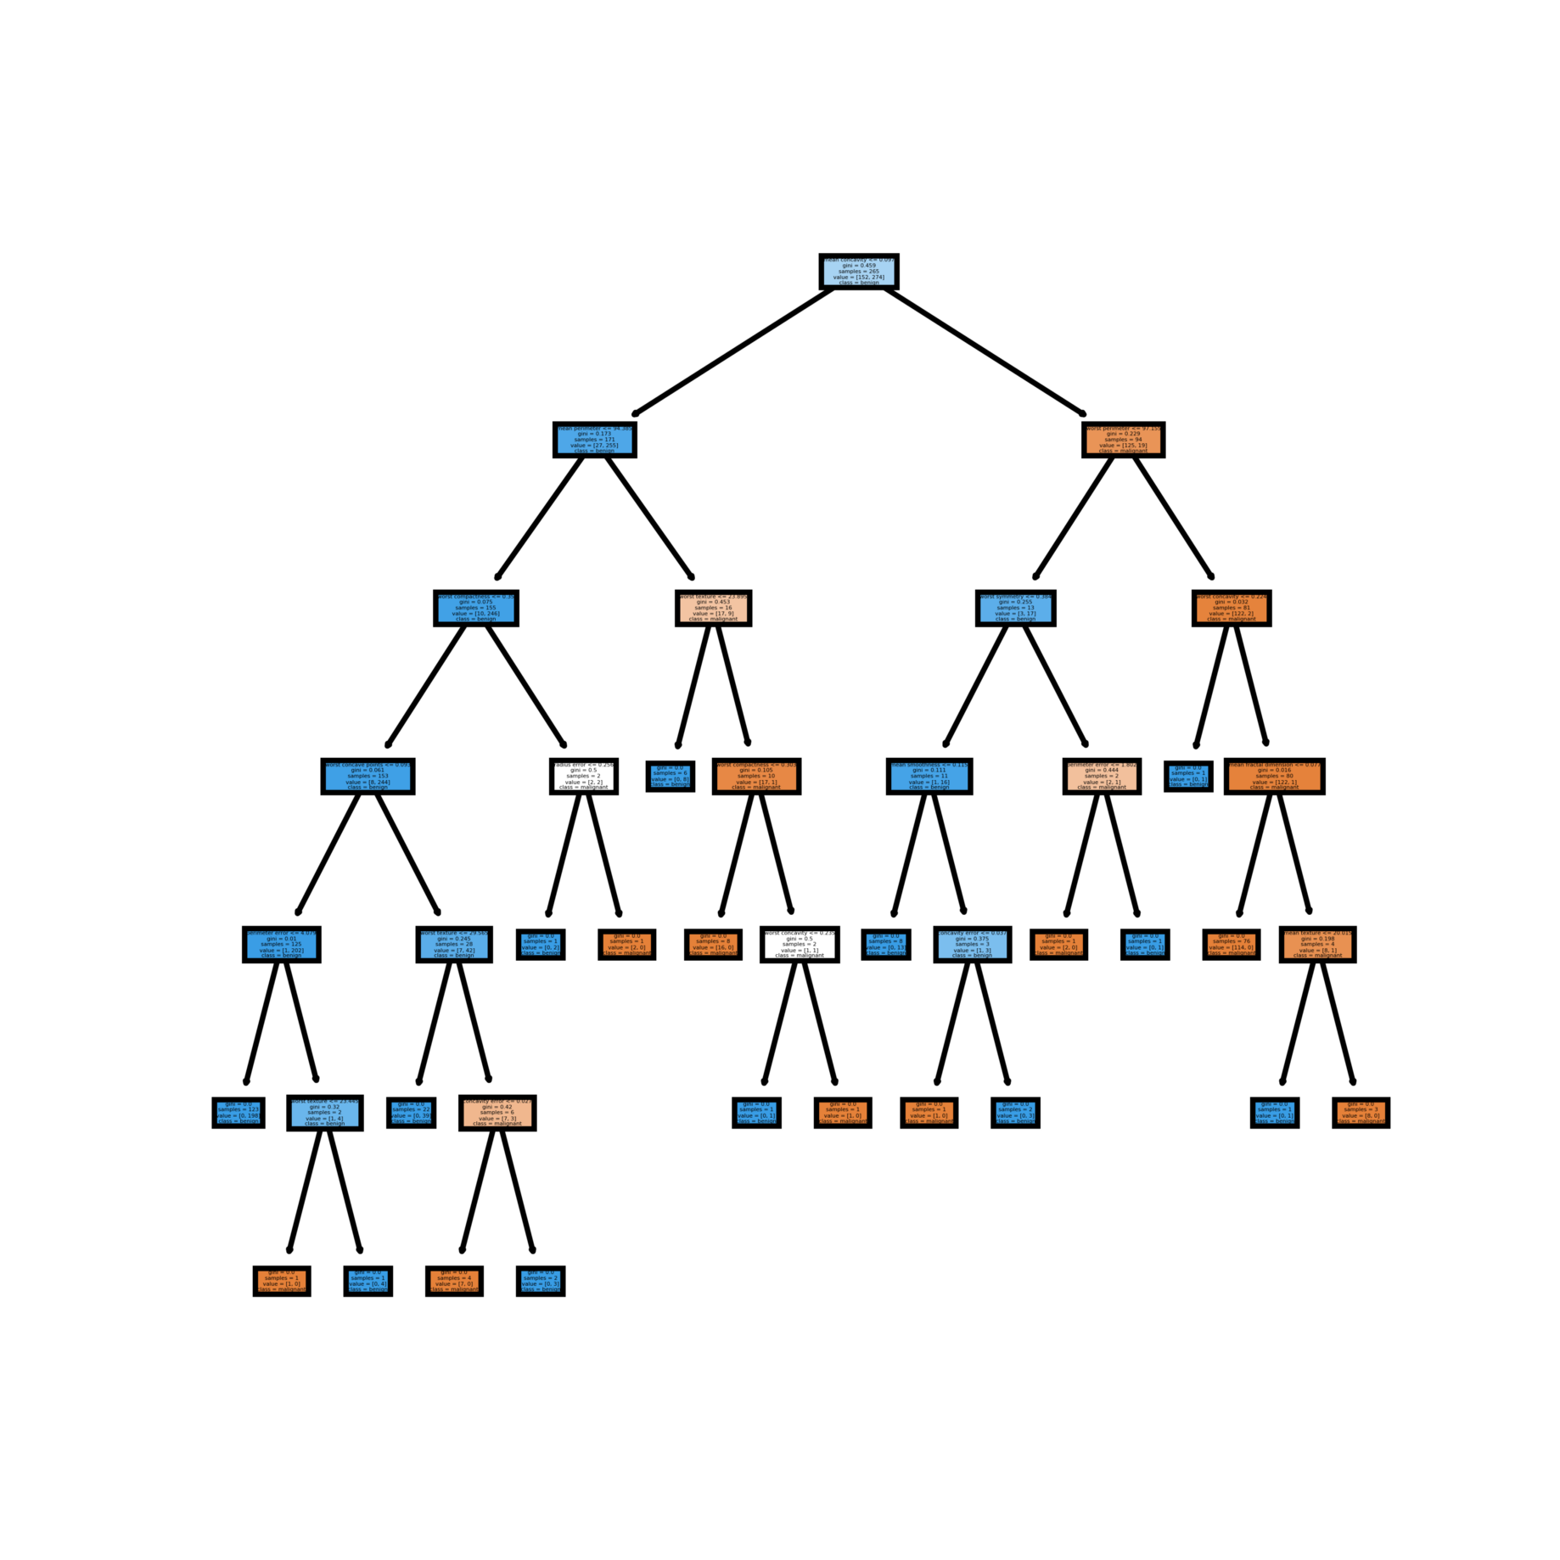
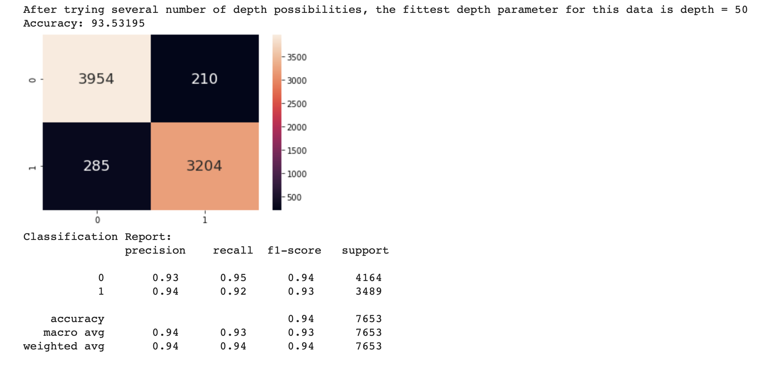
Decision Tree
In this Model, we try several different maximum depth value which results in value of Max_depth = 50 to be most suitable for the data with 93.5% accuracy on test data

Slide 23
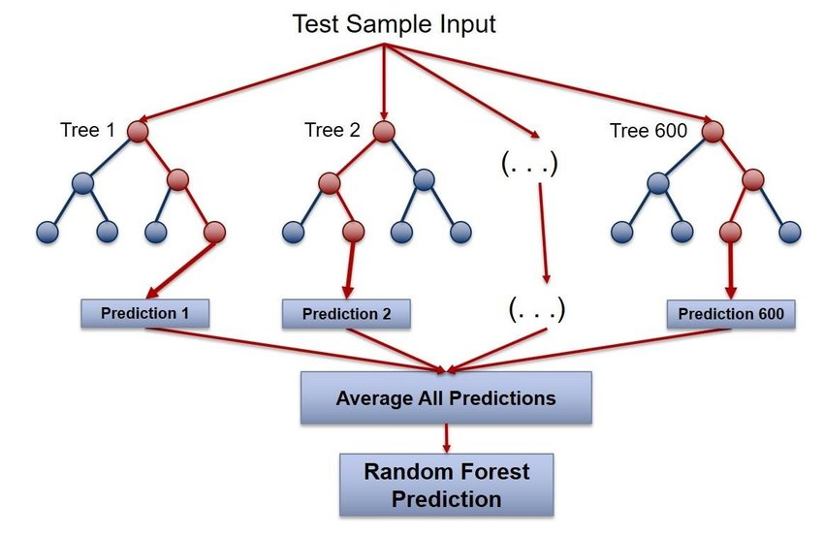
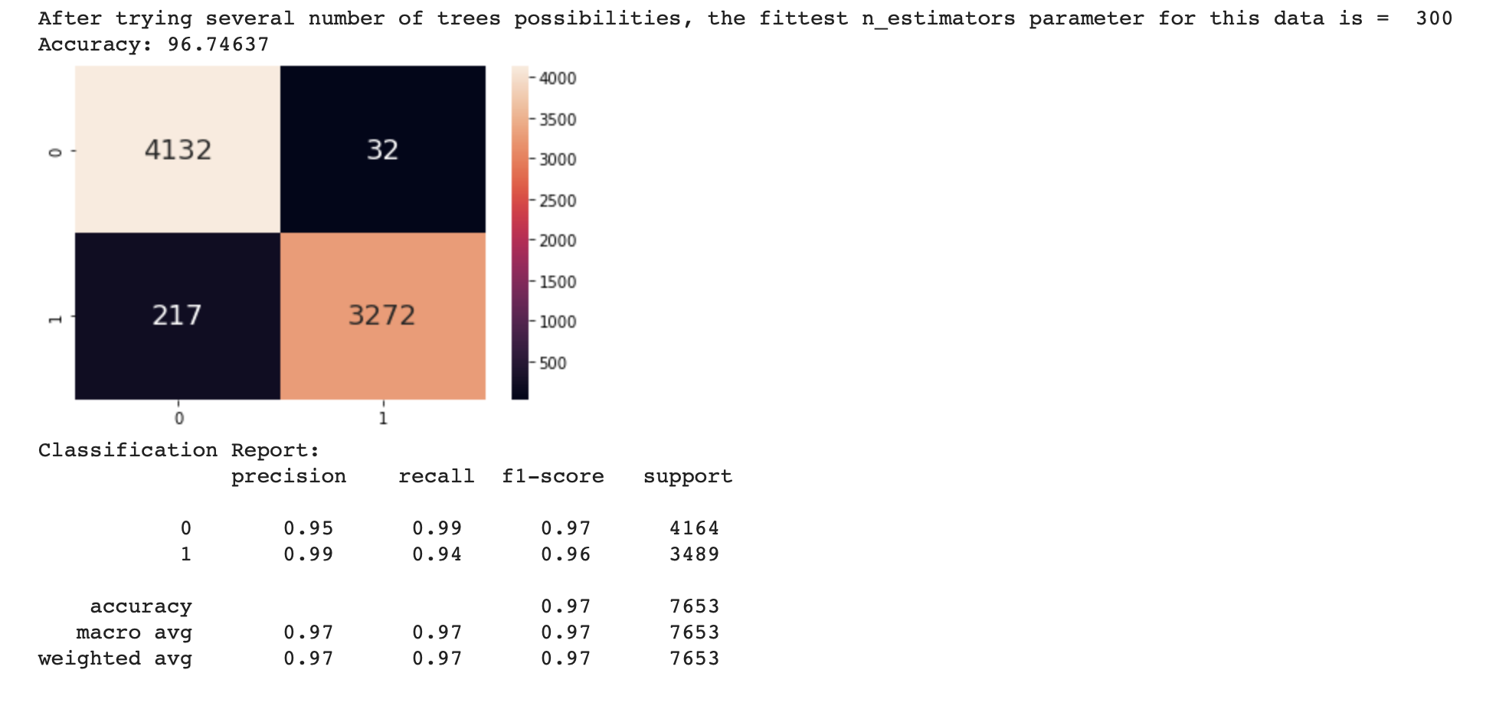
Random Forest
In this Model,we use the best depth from before and we try several different number of trees in the forest which results in value of number of trees or n_estimator = 300 to be most suitable for the data with 96.7% accuracy on test data

Slide 24
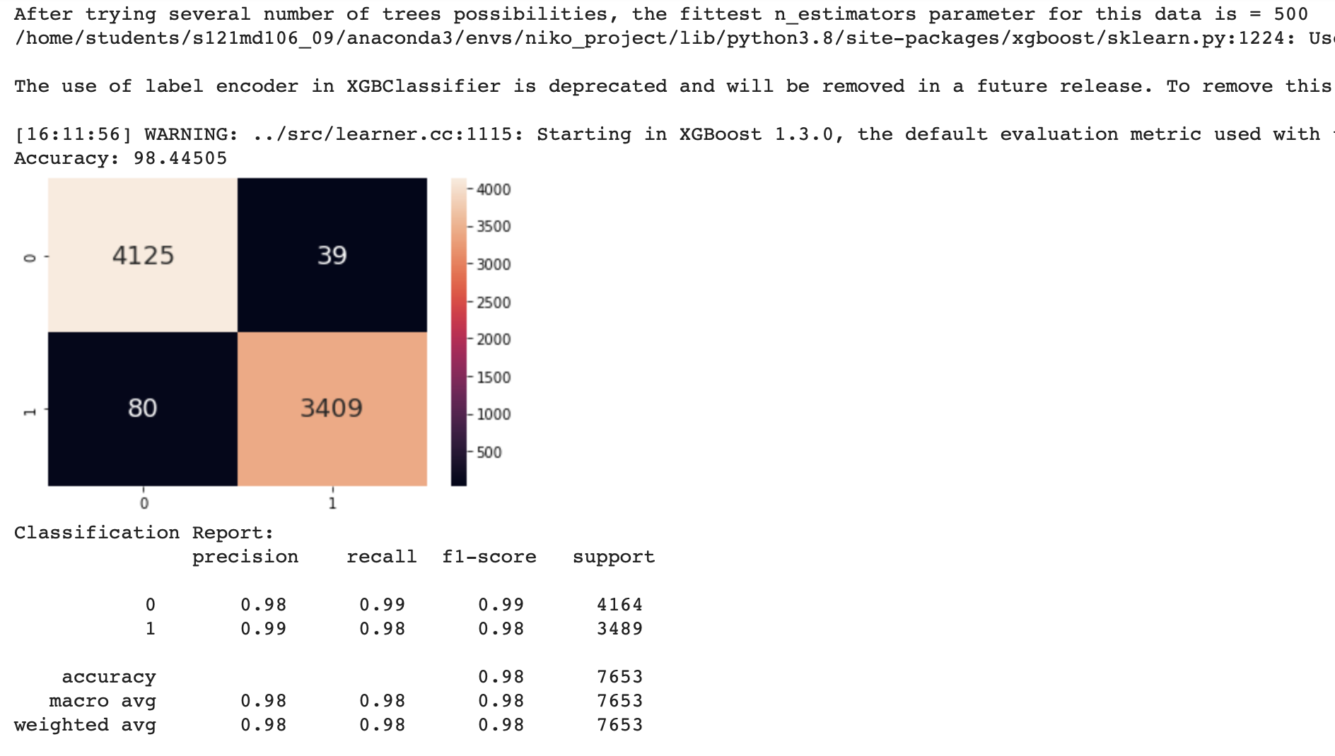
XGBoost
In this Model, we use the best depth from the decision tree mode and we try several different number of iteration used which results in value of n_estimators = 500 to be most suitable for the data with 98.4% accuracy on test data

Slide 25
Conclusion
For Using TF_IDF method, we can see from our result that using linear SVM is the better out of the 4 classifier that we try in this dataset

Slide 26
An unsupervised learning algorithm used to obtain vector representation of words
GloVe

Slide 27
GloVe Model Steps
Tokenize
Padding
Word Embedding
using pre-trained GloVe
Modelling
Using LSTM
Tokenizer will assign an integer value (starting from 1) to each word based on their frequency
Sequences are padded to uniform max length
Notes:
Tokenizer finds the frequency of each unique word and sort them based on their frequency. Then, it will assign an integer value (starting from 1) to each word from the top.
Padding: Sequences that are shorter than max length are padded, until they are max length long.
Sequences longer than max length are truncated.

Slide 28
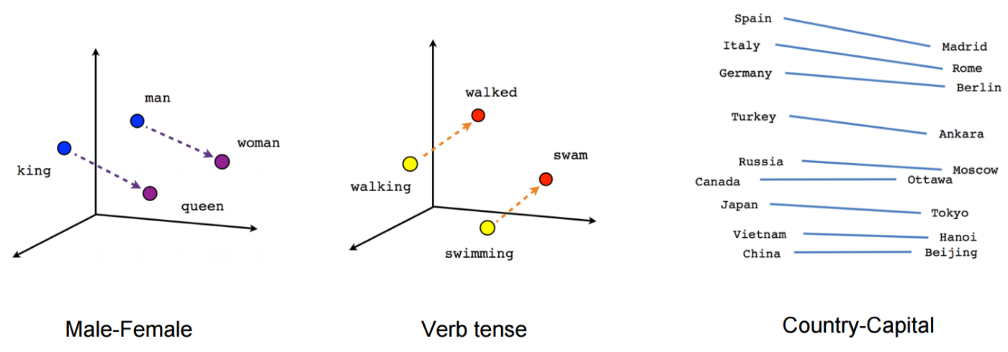
Word Embedding using pre-trained GloVe
Represent words with vector of real numbers in order for computers to understand human language. Here we use the GloVe techniques.
GloVe pre-trained word vectors data via: https://nlp.stanford.edu/projects/glove/)
We create an embedding matrix with GloVe vectors:
Embedding matrix with a shape of (vocab length, embedding dimension)
Each row of the matrix belongs to 1 word in the vocabulary & contains the weight of embedding vectors of the word.
Notes:
Represent words with vector of real numbers in order for computers to understand human language. Here we use the GloVe techniques.
GloVe pre-trained word vectors data via: https://nlp.stanford.edu/projects/glove/)
Size of vocabulary in GloVe: 400,000
We create an embedding matrix with GloVe vectors:
Embedding matrix with a shape of (vocab length, embedding dimension)
Each row of the matrix belongs to 1 word in the vocabulary & contains the weight of embedding vectors of the word.
Vocab length : len(word_index)+1 # word_index from Tokenizer
Embedding dimension : 100 # size of vector space in which word will be embedded

Slide 29

Long Short Term Memory (LSTM)
LSTM is special kind of RNN that is explicitly designed to avoid long term dependencies. LSTMs also have the chain like structure, but the repeating module has a different structure. There are four neural network layer, interacting in a very special way.

Slide 30
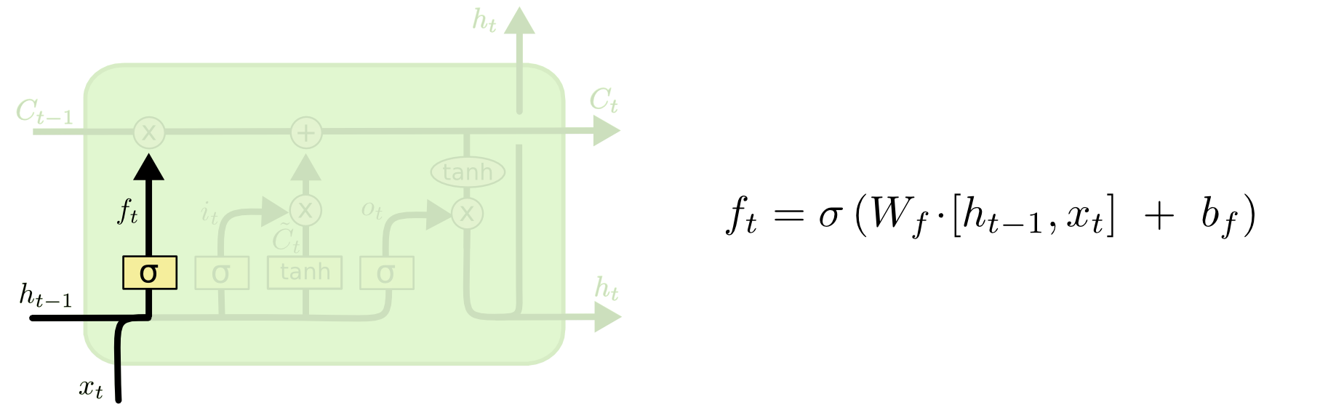
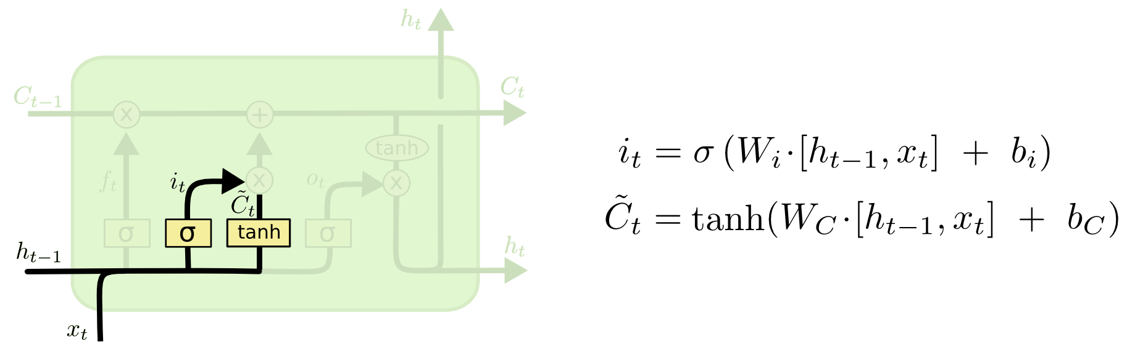
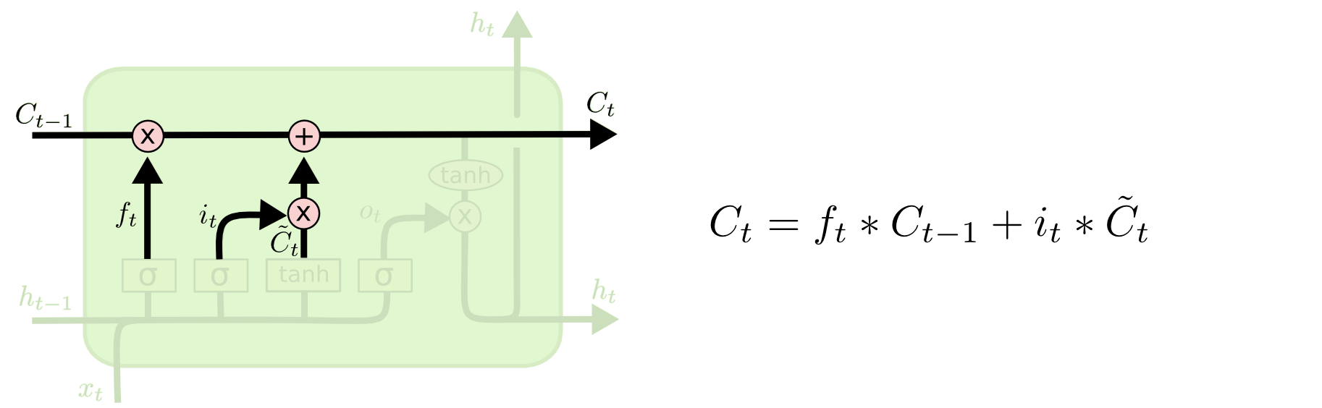
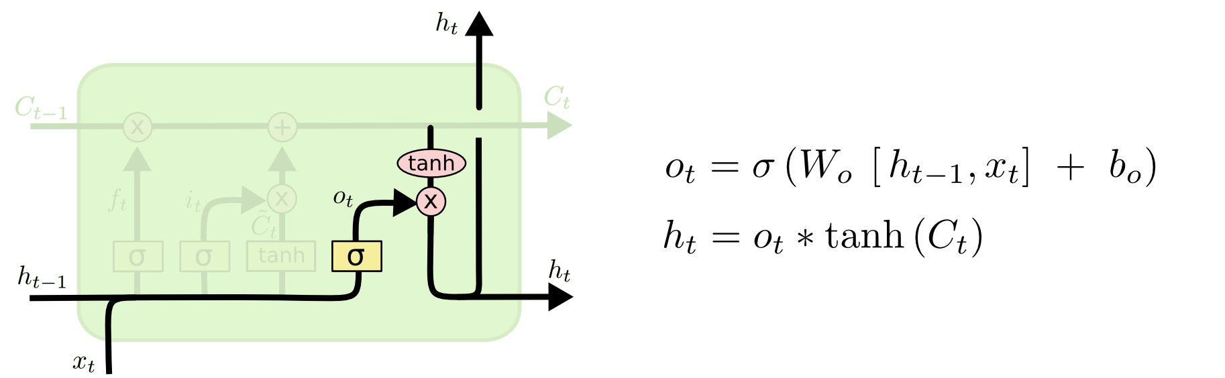
Forget Gate
Input Gate
Update old cell state
Output Gate
Notes:
Forget Layer Gate
Decide what information we’re going to throw away from the cell state.
i.e. When we see new subject, we want to forget the gender of old subject
Input Gate
Decide what new information we’re going to store in the cell state
Sigmoid (input layer gate, decide which values we’ll update) → tanh layer (creates vector of new candidate values)
i.e. add gender of new subject to cell state, replace the old
Update old cell state
Drop info about old subject’s gender, add new info
Output
i.e. output whether the subject is singular/plural

Slide 31
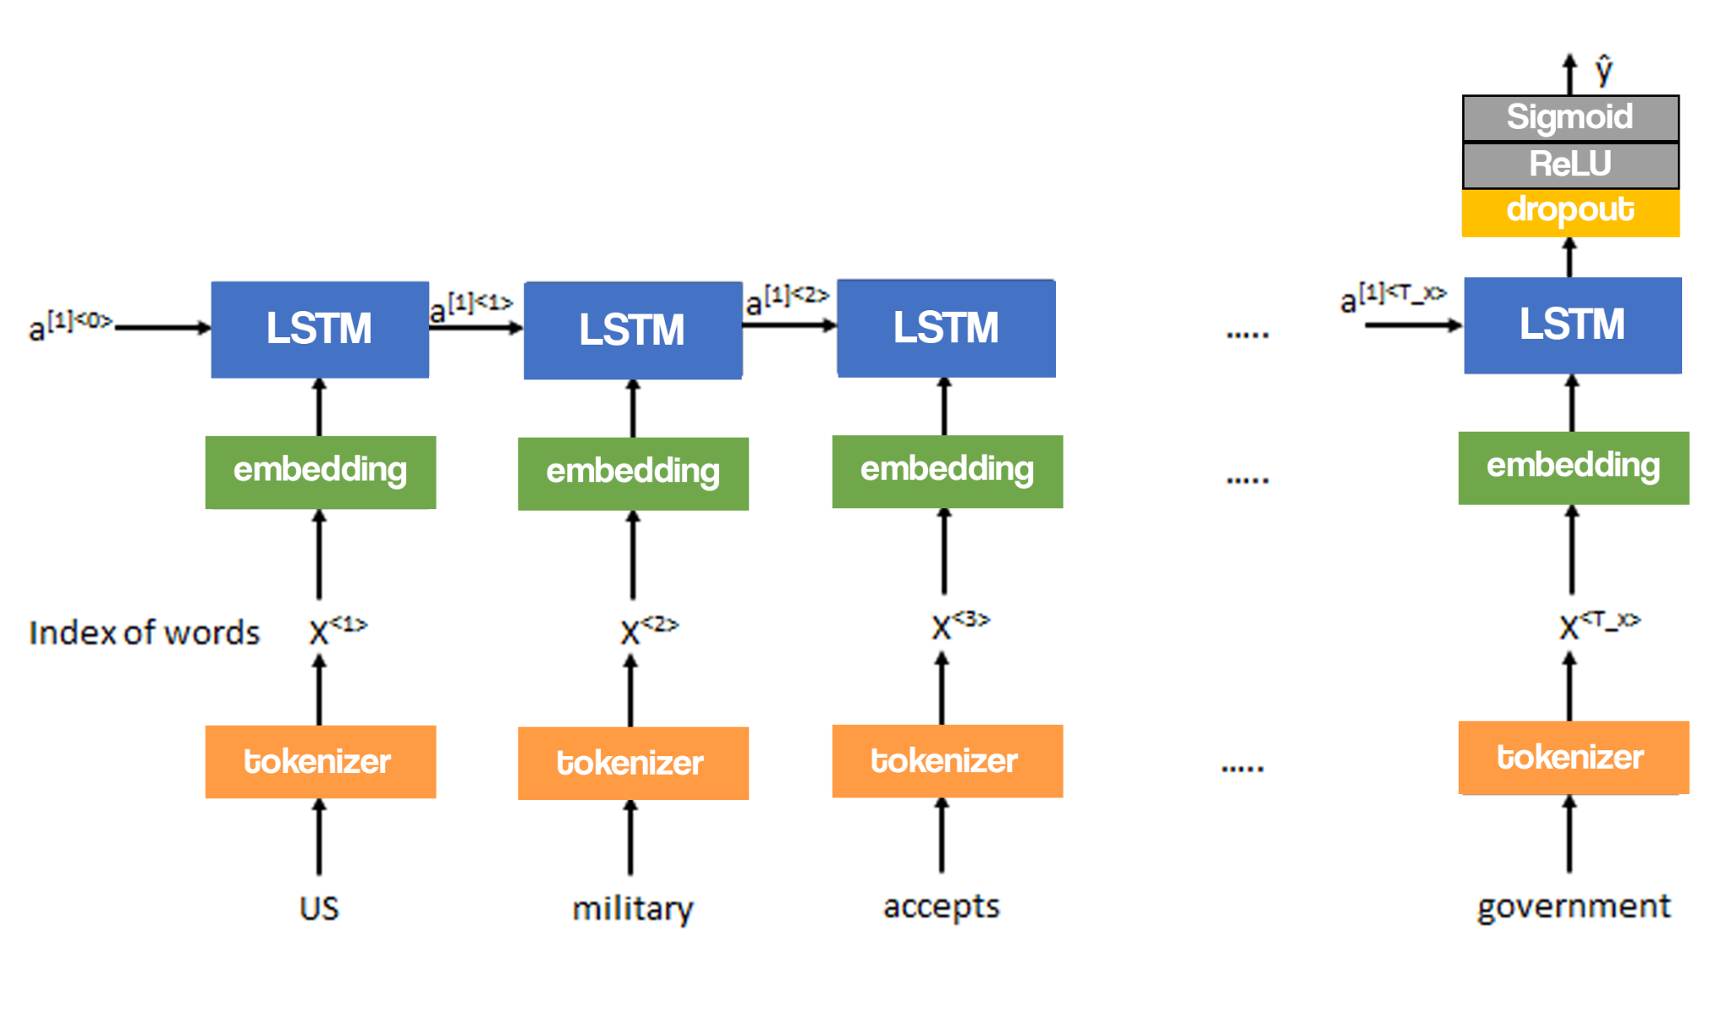
Our Model Architecture
Notes:
After went through a tokenization, we get the index representation of each words.
Then we proceed to the first layer which is Embedding layer to position them close to the word that surrounds them, and its weight is the embedding matrix we’ve done previously.
Next layer is LSTM, we try three different output sizes which are 64, 128, and 256, and we don’t want the output of the previous LSTM layers to be used in the next layers.
Third layer is dropout, where we dropping out neurons at random to keep as away as possible from overfitting.
Fourth layer is dense layer that use ReLU activation function to overcomes the vanishing gradient problem, allowing models to perform better.
Output layer is dense layer that use Sigmoid activation function with output of size 1, its outputs ranging from 0 to 1, since we are doing binary classification.

Slide 32
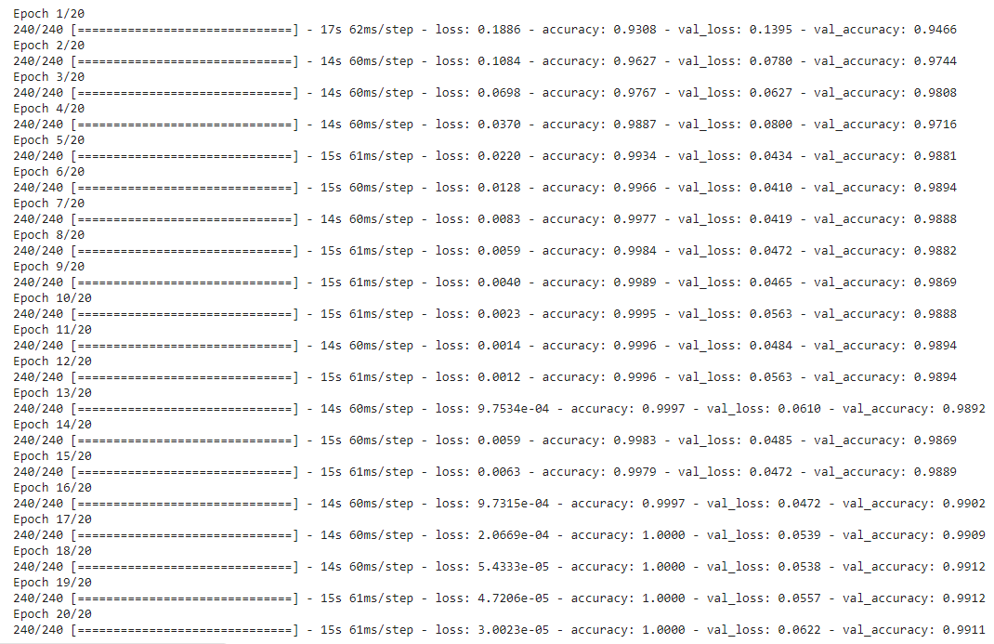
Model Fitting into Training and Testing Dataset
Number of epochs = 20
We have 4 variables:
Loss
Accuracy
Validation loss
(loss for the test dataset)
Validation accuracy
(loss for the train dataset)

Slide 33
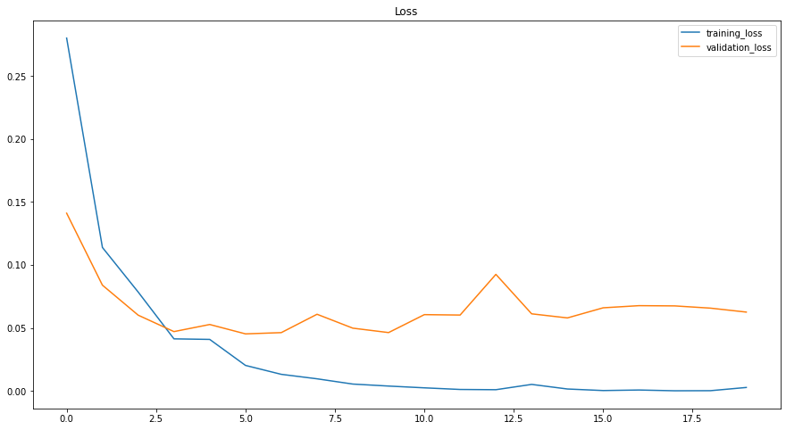
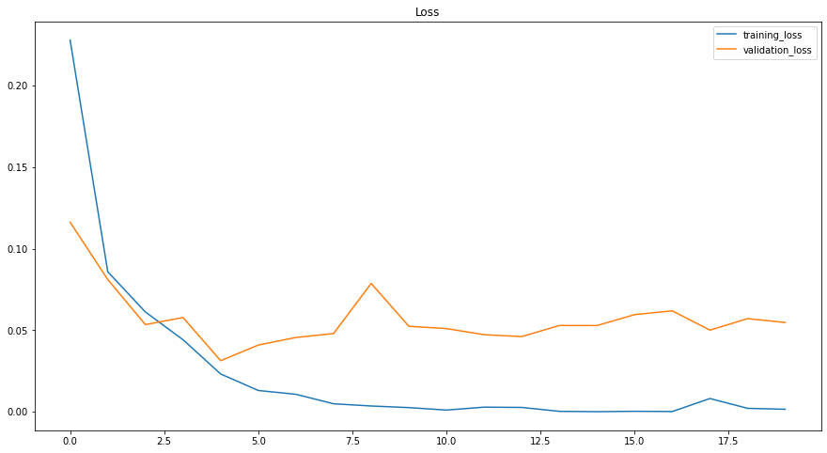
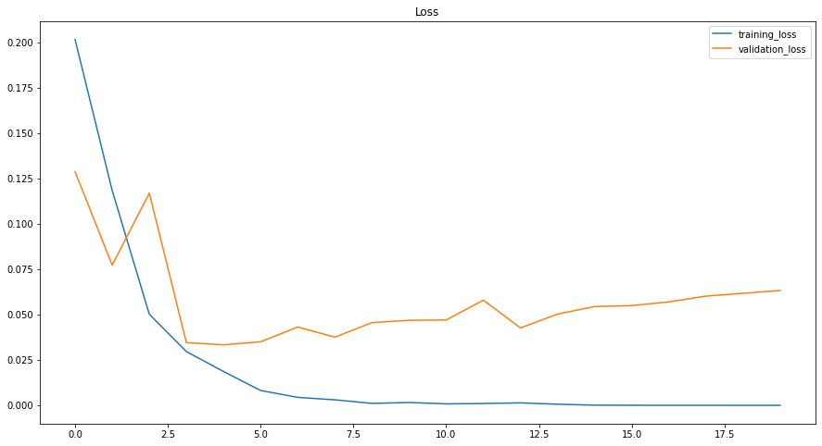
Evaluation of LSTM Model
n=64
n=128
n=256
Loss Rate for Training and Testing Dataset

Slide 34
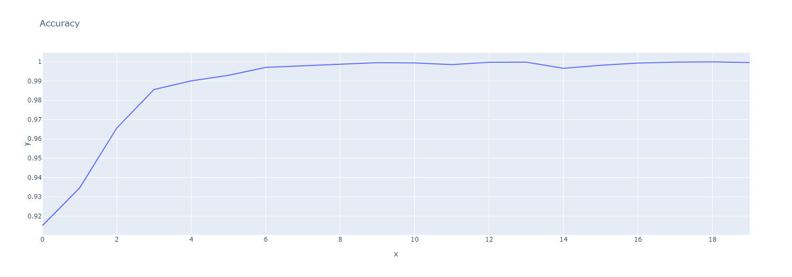
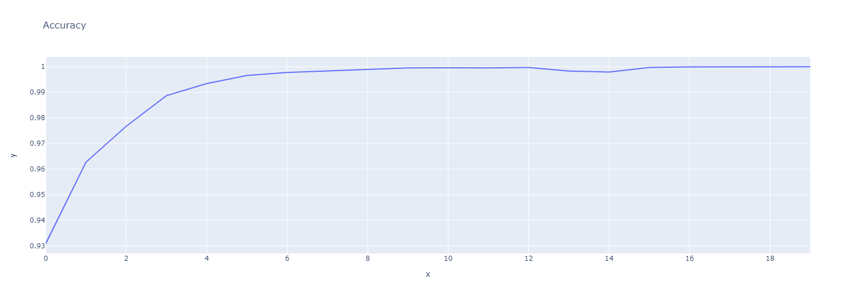
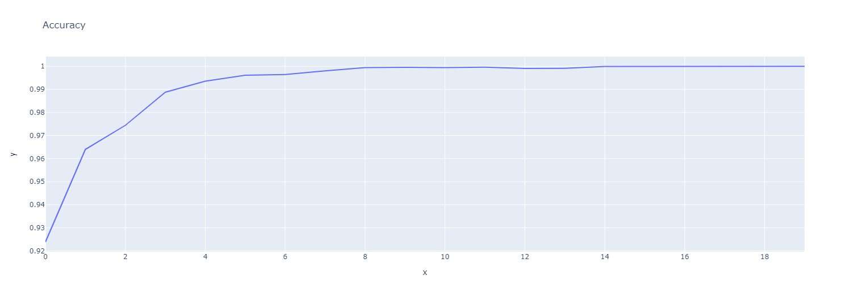
n=64
Accuracy rate
for training
dataset
n=128
n=256

Slide 35
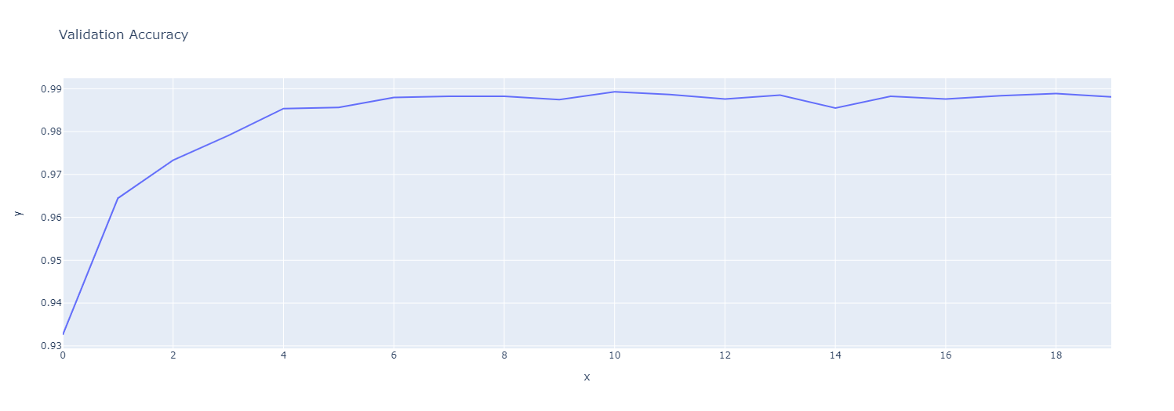
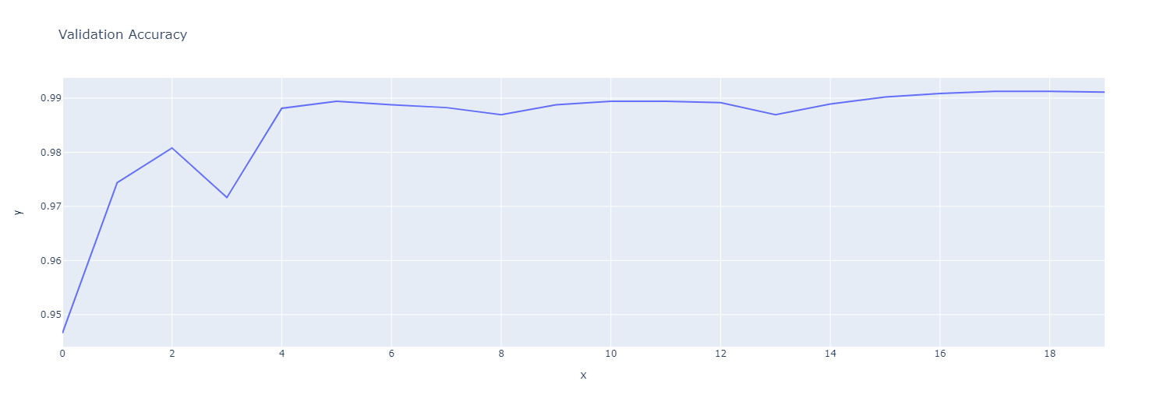
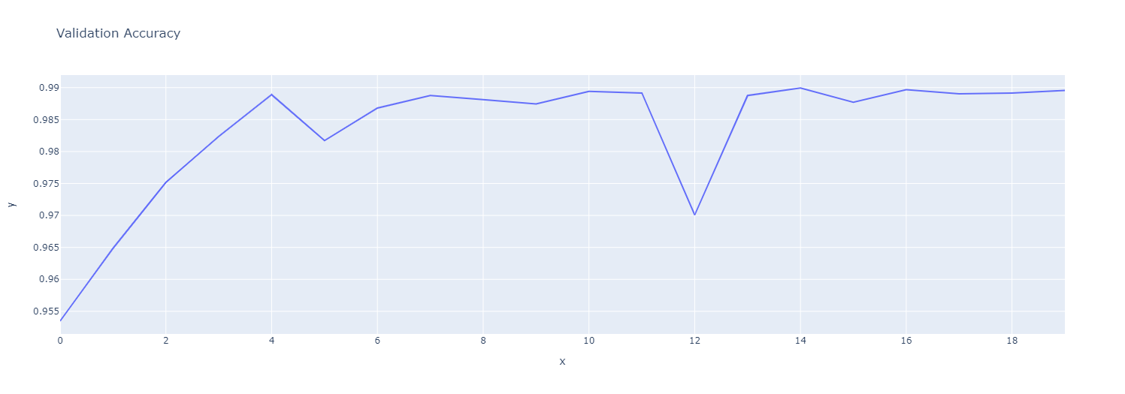
n=64
Accuracy rate
for testing dataset
n=128
n=256

Slide 36
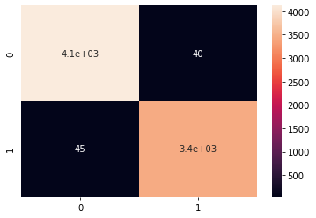


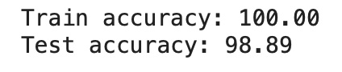
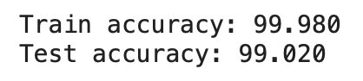
Evaluation of LSTM Model
n=64
n=128
n=256
Notes:
With higher output sizes, we are able to achieve higher accuracy for the test dataset, that reaches 99.111%. We can see that using 128 output size, we are able to achieve same accuracy with 256 output size. Therefore, we can conclude the n=128 to be the best option for this model.

Slide 37
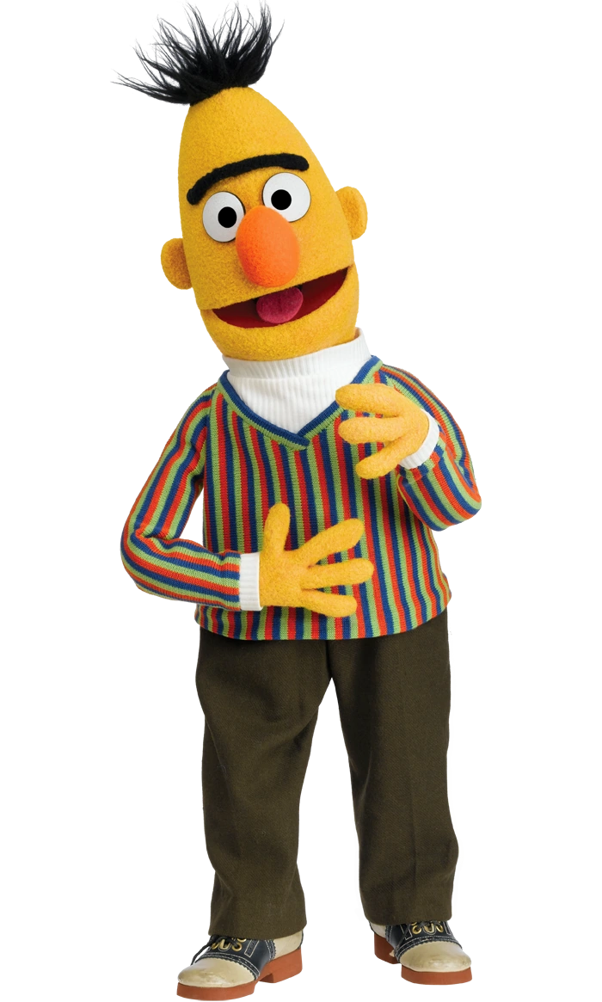
BERT

Slide 38
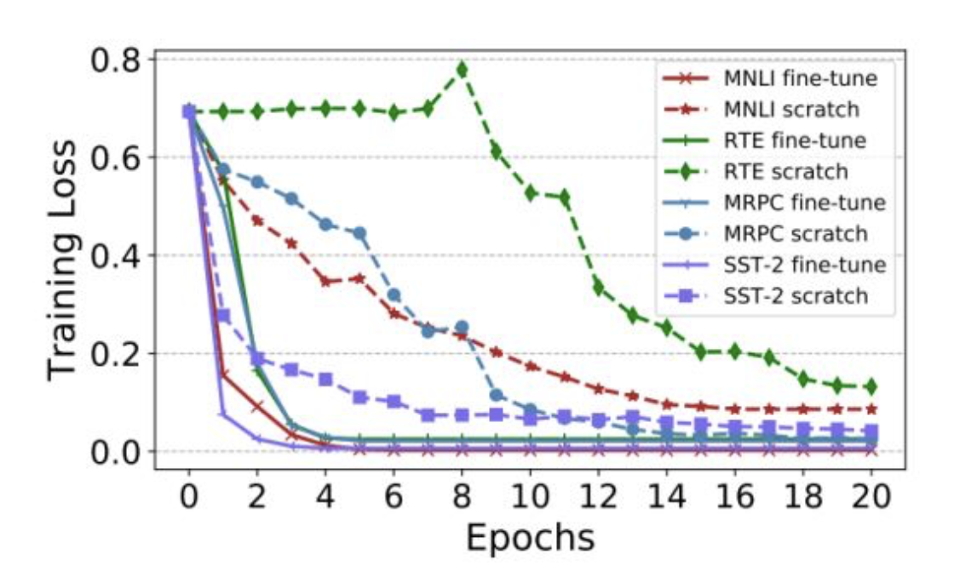
Transfer Learning
Definition for transfer learning:
Pre-training a neural network model on a known task, for instance ImageNet, and then performing fine-tuning — using the trained neural network as the basis of a new purpose-specific model.

Slide 39
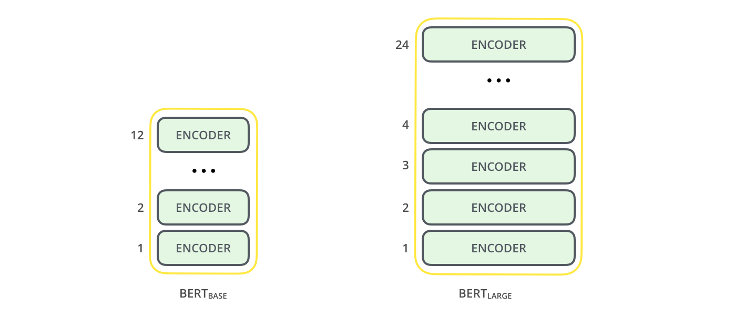
BERT Architecture
BERT (Bidirectional Encoder Representations from Transformers) is a trained Transformer Encoder stack that was created by Google
Applications of BERT includes text encoding, text summarization, response selection, question answering, etc
Notes:
BERT stands for Bidirectional Encoder Representations from Transformeres is a trained Transformer Encoder stack that was created by Google. BERT is commonly used in text encoding, text summarization, response selection, question answering, text classification, and etc.

Slide 40
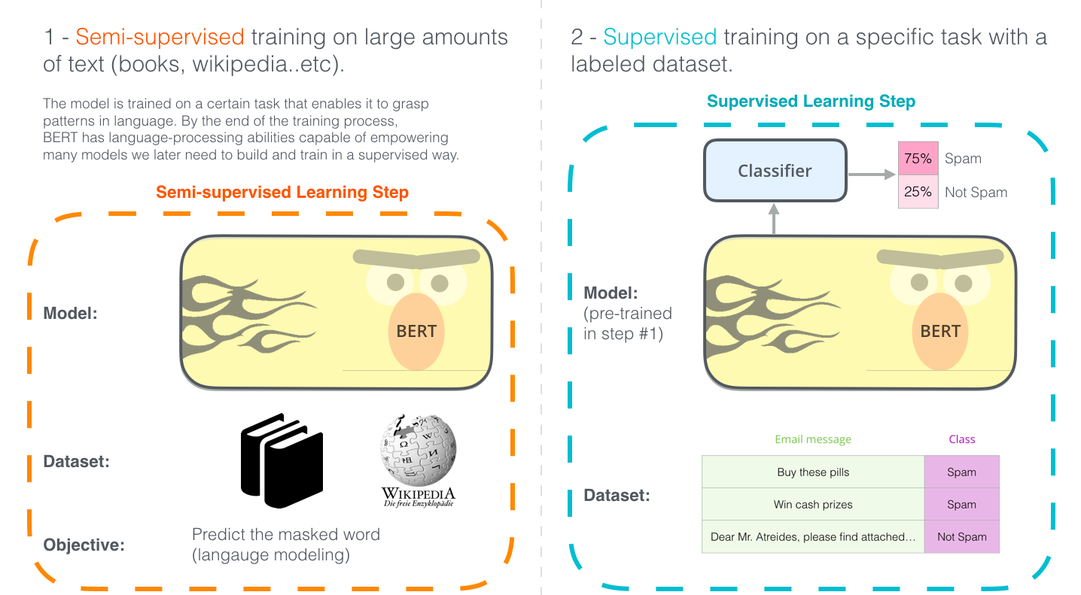
BERT
Notes:
BERT was trained on large amounts of text data from wikipedia and corpus dictionary, and then we do transfer learning by fine tuning the BERT model with a classifier.

Slide 41
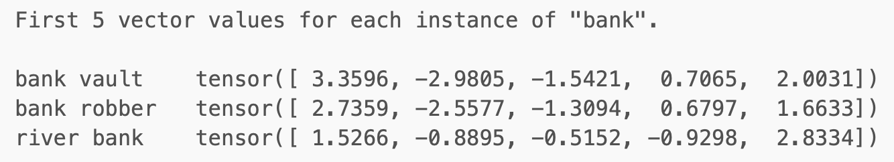
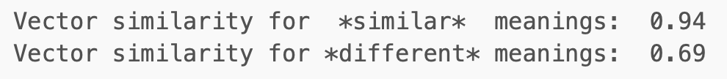
Context-dependent
GloVe embedding for the word “bank” will be a confused representation as it has collapsed different contexts into a single vector.
The BERT embedding will be able to distinguish and capture the two different semantic meanings by producing two different vectors for the same word “bank”.
text = "After stealing money from the bank vault, the bank robber was seen fishing on the Mississippi river bank."
Notes:
Compared to GloVe, BERT is able to create context-dependent embedding that is able to distinguish and capture the two different semantic meanings.

Slide 42
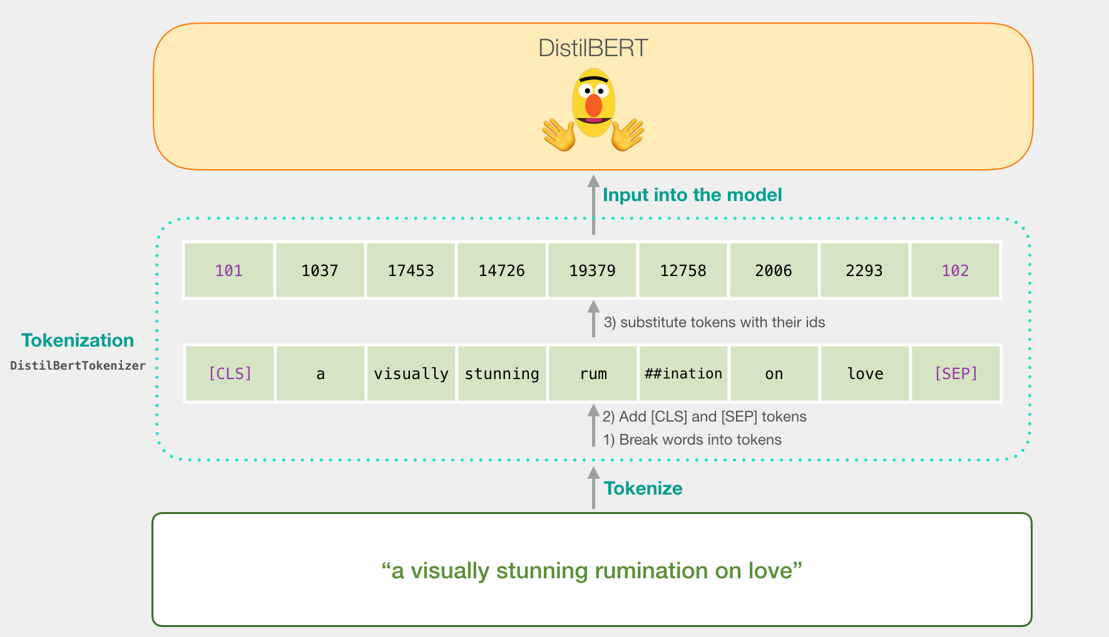
How BERT works
Notes:
To use BERT, we need to first preprocess the data. There are 3 steps, splitting those text into tokens, and then we add the special tokens for BERT which is [CLS] and [SEP], and lastly substituting the tokens with their ids from the embedding table that we get with the trained model.

Slide 43
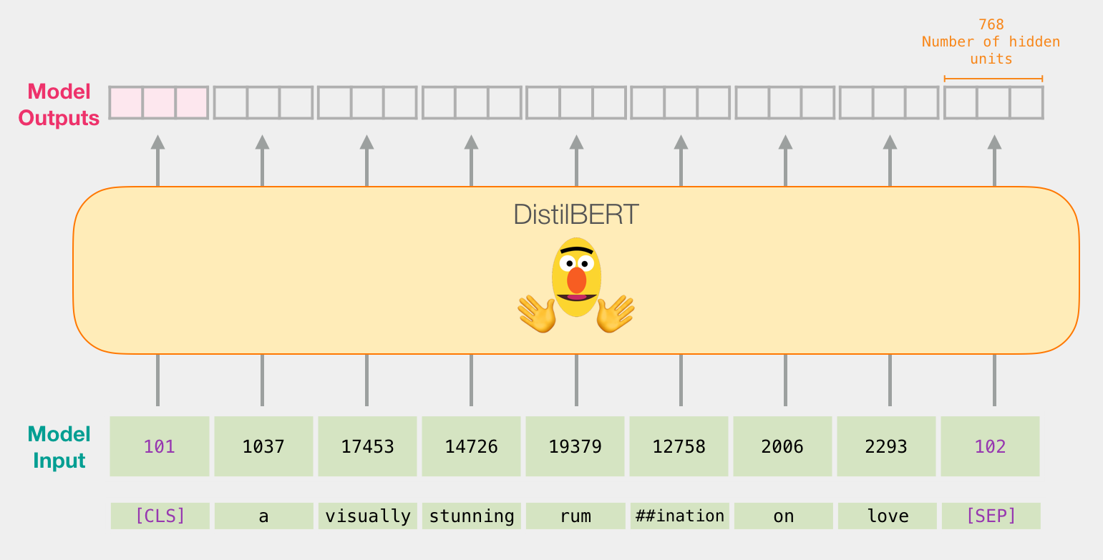
How BERT works
Notes:
After that the data is ready to be fed into the model. BERT will take these sequences and process it through each encoder layer and then handle it off to the next layer.
Each position outputs a vector of size 768 (in BERT Base), we then only focus on the output of the first position [CLS] token which we can think of as the representative of the whole sentence.

Slide 44
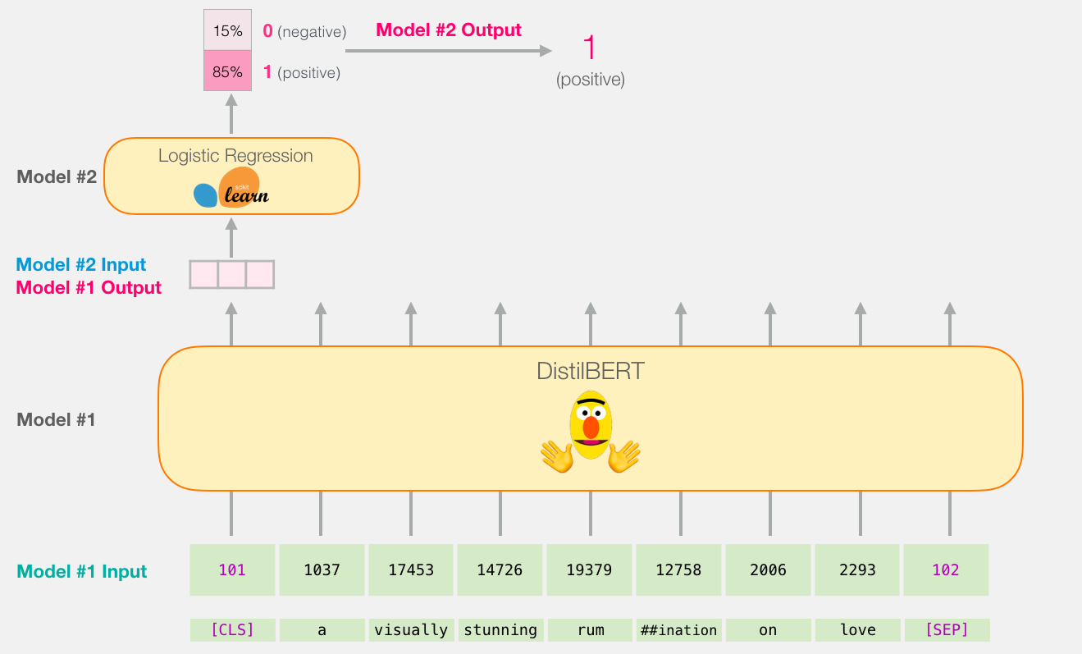
How BERT works
Classifier
Neural - network + Softmax

Slide 45
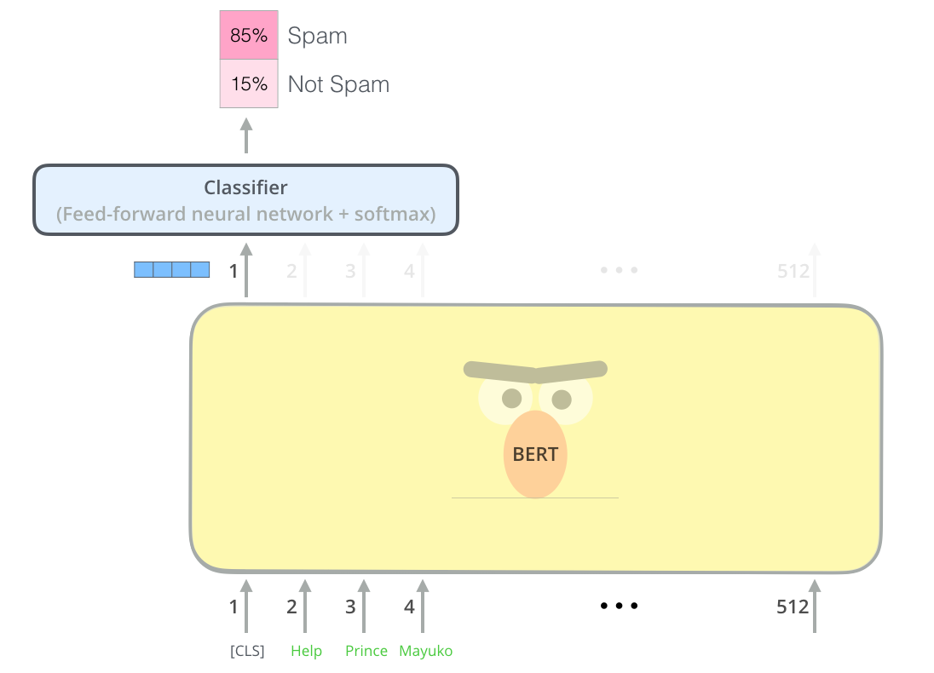
Model Outputs:
Fake
Real
Notes:
These results will then be passed to the feed - forward neural network and the softmax for the classification process.

Slide 46
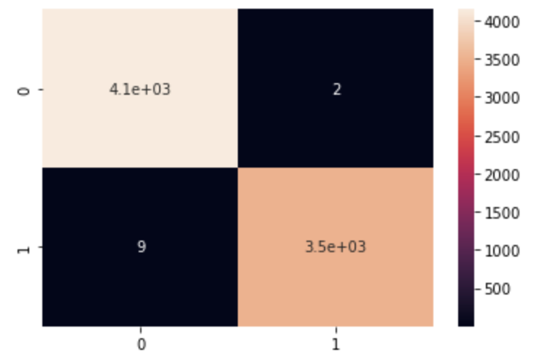
Result with BERT
We use DistilBERT, a small, fast, cheap and light Transformer model
For our model, we split the data into 80% train size and 20% validation size
Train for 3 epoch
Calculate the accuracy on 20% validation set
Able to achieve accuracy of 99.8%
Epoch | Validation Loss | Accuracy
1 | 0.008467 | 0.998171
2 | 0.007099 | 0.998563
3 | 0.006784 | 0.998563
Notes:
Applying those models to our fake news classification problems, we decided to use DistilBERT which is a smaller version of BERT developed and open sourced by the team at HuggingFace.
After we split the data into training and validation sets, we trained it for 3 epochs and tested the accuracy on the validation set.
The model is able to achieved accuracy of 99.8%

Slide 47

Project
Demo
Time To Prove Our Model!

Slide 48
References
https://xgboost.readthedocs.io/en/latest/tutorials/rf.html
https://scikit-learn.org/stable/
https://stanford.edu/~shervine/teaching/cs-229/cheatsheet-supervised-learning
https://www.tensorflow.org/api_docs/python/tf/keras/
https://stanford.edu/~shervine/teaching/cs-230/cheatsheet-recurrent-neural-networks
https://colah.github.io/posts/2015-08-Understanding-LSTMs/
https://huggingface.co
https://jalammar.github.io/illustrated-bert/

